Slide 1
Theories of Corporate Governance
It has been contended that corporate governance practices is not a standard mode (not a “one size fits all”) and thus cannot operate in any standard form but rather vary across nations and firms (OECD, 2000).
www.todayscience.org/jbmJournal of Business & Management Vol. 1, Issue 1; 2012

Slide 2
Understanding of Agency Theory
Agents or managers may not always act in the best interest of shareholders when the control of a company is separate from its ownership.
In June 1959, Simon Herbert (quoted in Baysinger and Hoskisson, 1990) proclaimed that managers might be “satisfiers” rather than “maximisers,” that is, they tend to play it safe and seek an acceptable level of growth because they are more concerned with perpetuating their own existence than with maximising the value of the firm to its shareholders.
But shareholders delegate decision-making authority to the agent (CEO) with the expectation that the agent will act in their best interest.
A comprehensive theory of the firm under agency arrangements was developed by Jensen and Meckling (1976), who show that the principals (the shareholders) can assure themselves that the agent will make the optimal decisions only if appropriate incentives are given and only if the agent is monitored.
Incentives include such things as stockoptions, bonuses and prerequisites which are directly related to how well the results of management’s decisions serve the interests of shareholders.

Slide 3
Monitoring consists of bonding the agent, systematic reviews of management prerequisites, financial audits, and placing specific limits on management decisions. These involve costs, which are an inevitable result of the separation of corporate ownership and control. Such costs are not necessarily bad for shareholders, but the monitoring activity they cover needs to be efficient.
In contrast, Demesetz (1983) and Fama and Jensen (1983) suggest that the primary monitoring of managers comes not from the owners but from the managerial labour market. It is argued that management control of a large corporation is completely separate from its security ownership. Efficient capital markets provide signals a bout the value of a company’s securities and thus about the performance of its managers.
If the managerial labor market is competitive both within and outside the firm, it will tend to discipline the manager. Therefore, the signals given by changes in the total market value of the firm’s securities become very important.
http://www.kantakji.com/media/9422/file689.pdf

Slide 4
Agency Theory
Agency theory having its roots in economic theory was exposited by Alchian and Demsetz (1972) and further developed by Jensen and Meckling (1976).
Agency theory is defined as
“the relationship between the principals, such as shareholders and agents such as the company executives and managers .In this theory, shareholders who are the owners or principals of the company, hires the agents to perform work. Principals delegate the running of business to the directors or managers, who are the shareholder’s agents”.

Slide 5
Berle and Means regarded corporate governance as a mechanism where a board of directors is a crucial monitoring device to minimize the problems brought about by the principal-agent relationship. In this context, agents are the managers, principals are the owners and the boards of directors act as the monitoring mechanism.

Slide 6
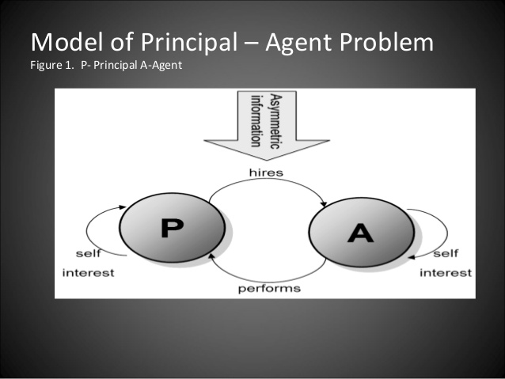

Slide 7
Agency Theory Contd.
Literature on corporate governance attributes two factors to agency theory. The first factor is that corporations are :
Reduced to two participants, managers and shareholders whose interests are assumed to be both clear and consistent.
A second notion is that humans are self interested and disinclined to sacrifice their personal interests for the interests of the others.

Slide 8
Agency Theory Contd
As applied to corporate governance the theory suggests a fundamental problem for absent or distant owners/shareholders who employ professional executives to act on their behalf.
In line with neo-classical economics, the root assumption informing this theory is that the agent is likely to be self-interested and opportunistic.
This raises the prospect that the executive, as agent, will serve their own interests rather than those of the owner principal.

Slide 9
Agency Theory Contd.
Model of an employee in the agency theory
A self-interested, individualistic and bounded rationality where rewards and punishments seem to take priority.
Agents or managers may not always act in the best interest of shareholders when the control of a company is separate from its ownership. In June 1959, Simon Herbert (quoted in Baysinger and Hoskisson, 1990) proclaimed that managers might be “satisfiers” rather than “maximisers,” that is, they tend to play it safe and seek an acceptable level of growth because they are more concerned with perpetuating their own existence than with maximising the value of the firm to its shareholders. But shareholders delegate decision-making authority to the agent (CEO) with the expectation that the agent will act in their best interest.

Slide 10
Agency Theory Contd.
Agency Costs
To counter such problems the principal will have to incur ‘Agency costs'; costs that arise from the necessity of creating incentives (Stock options)that align the interests of the executive with those of the shareholder, and costs incurred by the necessity of monitoring executive conduct to prevent the abuse of owner interests. Gathering more information on what the agent is doing (e.g., the costs of producing financial statement )
Agency theorists point to the important disciplinary effects of two further market mechanisms.
Market for corporate control: the potential for takeovers to discipline executives by providing a mechanism whereby ineffective executive teams can be displaced by more effective executive teams.
Dutch Beer Heineken raised its shareholding in United Breweries to 42% leaving Mallya’s share to 32%.United Spirits Board has asked Mallya to step down as Chairman after PWC investigation into the company’s account exposed violations and irregularities.
The managerial labor market' : Individual level;
poor executive performance will threaten an individual's future employment potential whilst good performance will have positive reputational and hence career-enhancing effects.
Fama, Eugene F.Jenson, Michael C. (1983). "Agency Problems and Residual Claims". Journal of Law & Economics 26: 327–349. doi:10.2139/ssrn.94032. SSRN 94032

Slide 11
Agency theory and Reforms in Corporate Governance
Agency theory assumptions have nevertheless been highly influential is shaping the reform of corporate governance systems.
Formally, it is the Annual General Meeting provides an opportunity for directors to report face-to-face to their shareholders.
Internal reform of boards of directors. One of its most significant direct contributions came in the form of the widespread adoption of executive share-option scheme

Slide 12
Agency theory and Reforms in Corporate Governance Contd.
Influence of agency theory assumptions can be seen in the seminal reforms promoted by the Cadbury Committee 'Code of Best Practice', and its subsequent elaboration by Greenbury, Hampel, Turnbull and most recently Derek Higgs.
The 'independence' of the non-executives directors
Who must now constitute 50 %of the board,
Their lead role on audit,
Nominations and remuneration committees where conflicts of interest between executive and shareholder are potentially most acute,
Progressively more stringent provisions around the separation of the roles of chairman and chief executive.
Above all consonant with agency theory's assumption that the interests of the owner/ shareholder are potentially at risk from executive self-interest, in the absence of close monitoring by independent non-executives.

Slide 13
Resource Dependence Theory
Resource dependence ideas were originally developed by Pfeffer and Salancik (1978) in the late 1970s.
The basic proposition of resource dependence theory is the need for environmental linkages between the firm and outside resources. In this perspective, directors serve to connect the firm with external factors by co-opting the resources needed to survive (Pfeffer and Salancik, 1978). Thus, boards of directors are an important mechanism for absorbing critical elements of environmental uncertainty into the firm.
key contribution
Observation that the board, and in particular the constitution of the non-executive element of a board, can provide the firm with a vital set of resources:
'When an organization appoints an individual to a board, it expects the individual will come to support the organization, will concern himself with its problems, will variably present it to others, and will try to aid it'

Slide 14
Resource Dependence Theory
Seeing the board as a source of resources for a company opens up a very different way to think about the board's role in creating high performance.
Resources can take a variety of forms each of which can be argued to add to the 'capital' of a company (Hilman and Dalziel 2003).
Non-executive directors can be a source of expertise which executives can draw upon, both in the form of specific skills as well as advice and counsel in relation to strategy and its implementation.

Slide 15
Resource Dependence Theory
They can also serve as an important source of contacts, information and relationships that allow executives to better manage some of the uncertainties in the environment.
Practical and symbolic Role: the association of particular individuals with a company has the potential to enhance the reputation or perceived legitimacy of an executive team.

Slide 16
Resource Dependence: Needs of company at different stages of life cycle
Young entrepreneurial firm :
Non-executive is a relatively cheap source of part-time legal, financial or operational management skills that are not otherwise available to the entrepreneur.
Publicly listed
provision of expertise blended with 'grown-up governance'.
Here the value of the non-executive lies not only in their expertise but also through their networks that give the company ready access to new markets or to sources of finance, as well as in the reputation benefits that arise from an individual's association with the company.
This theory supports the appointment of directors to multiple boards because of their opportunities to gather information and network in various ways.

Slide 17
Difference between Agency and Resource Dependence Theory
Agency view of the non-executive emphasizes their local policing role on behalf of investors, Resource dependence theory sees the non-executive primarily as a context specific resource to support the performance of both the executives and the company.

Slide 18
Arun Sarin as Independent Director of Ola
Ola has roped in former Vodafone group CEO Arun Sarin on its board as an independent director.
Sarin will contribute in an advisory role to Ola's overall business strategy that will further drive growth and leadership in the market, Ola said in a statement.
Arun brings a global perspective and a strong understanding of emerging markets like India. His experience in management and in growing large companies is invaluable to Ola," Ola co-founder and CEO Bhavish Aggarwal said.
Sarin served as the chief executive officer of Vodafone Group Plc from 2003 to 2008.
He is currently a non-executive director of Cisco, Charles Schwab and Blackhawk Networks.

Slide 19
Stewardship theory
Contrary to agency theory's pessimistic assumptions about the self-interested and self-serving motives of executives, Stewardship theory suggests the potential for what it calls
the 'pro-organizational' motives of directors.
What drives performance here is not the aligned greed of an executive but their personal identification with the aims and purposes of the organization.
Stewardship theory refutes the assumption that executive aims and motives are opposed to those of the shareholder; both, it insists, have an interest in maximizing the long-term stewardship of a company and are therefore already well aligned.

Slide 20
Stewardship theory
From this stewardship theory suggests the potentially negative impact of a division of responsibilities between a chairman and chief executive.
The roles, it suggests, should remain combined in order to protect a key aspect of high performance; the strength and authority of executive leadership.

Slide 21
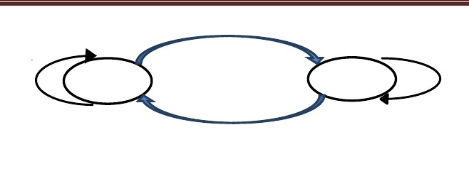
Empower & trust
Shareholders
Stewards
Intrinsic & Extrinsic motivation
Protect & maximize shareholder’s wealth
The Stewardship theory

Slide 22
Stakeholder Theory
These ideas were originally developed by Ed Freeman in the 1980s, but have achieved a wider currency in the UK.
Stakeholder theory challenges agency assumptions about the primacy of shareholder interests.
Instead it argues that a company should be managed in the interests of all its stakeholders.
These interests include not only those of the shareholder but also a range of other direct and indirect interests.

Slide 23
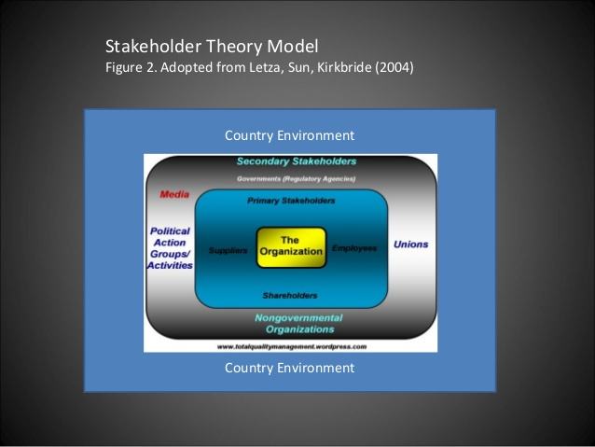

Slide 24
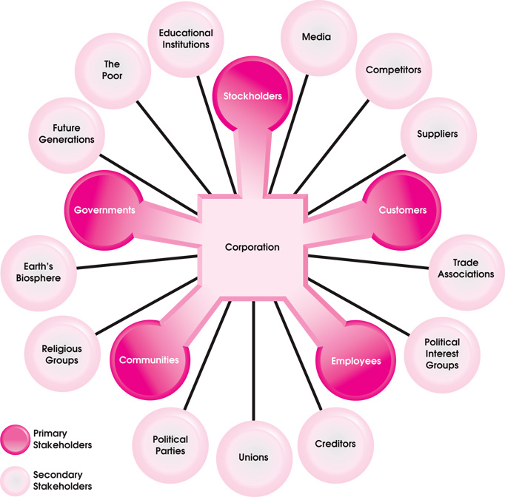
Stakeholder Theory

Slide 25
Stakeholder Theory
The argument that is repeatedly raised against a stakeholder view of the firm is that it is hard to operationalise because of the difficulties of deciding what weight should be given to different stakeholder interests.
In terms of corporate governance it is argued that, were executives to be made accountable to all of a company's stakeholders they would, in effect, be answerable to none.

Slide 26
Conclusion
The present corporate governance theories cannot fully explain the intricacy and heterogeneity of corporate business. Governance may differ from country to country due to their various cultural values, political and social and historical circumstances. In this sense, governance in developed countries and developing countries can vary due to the cultural and economic contexts of individual countries. However, the literature has confirmed that even with strict regulations, there have been breaches in corporate governance. Hence it is vital that a rounded recognition be driven across the corporate world that would bring about a different perspective towards corporate governance.

